Slide 1


Comparison of Yolo algorithm and faster r-cnn
Team members :
Abdelrahman Atef Mohamed 18p8622 Mostafa Mohamed nageb 1809079
Mustafa Ahmed Allam Attia 1803488

Slide 2
What is yolo ?
YOLO is an abbreviation for the term ‘You Only Look Once’. This is an algorithm that detects and recognizes various objects in a picture (in real-time). Object detection in YOLO is done as a regression problem and provides the class probabilities of the detected images.
YOLO algorithm employs convolutional neural networks (CNN) to detect objects in real-time. As the name suggests, the algorithm requires only a single forward propagation through a neural network to detect objects.
This means that prediction in the entire image is done in a single algorithm run. The CNN is used to predict various class probabilities and bounding boxes simultaneously.
Note: there are major differences between YOLOv3, and older versions occur in terms of speed, precision, and specificity of classes.

Slide 3
Why yolo algoritm ?
Speed: This algorithm improves the speed of detection because it can predict objects in real-time.
High accuracy: YOLO is a predictive technique that provides accurate results with minimal background errors.

Slide 4
How the YOLO algorithm works
YOLO algorithm works using the following three techniques:
Residual blocks
Bounding box regression
Intersection Over Union (IOU)

Slide 5

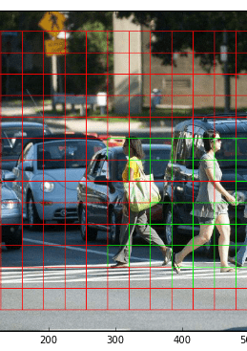
1-Residual blocks
First, the image is divided into various grids. Each grid has a dimension of S x S. The following image shows how an input image is divided into grids.
there are many grid cells of equal dimension. Every grid cell will detect objects that appear within them. For example, if an object center appears within a certain grid cell, then this cell will be responsible for detecting it.

Slide 6
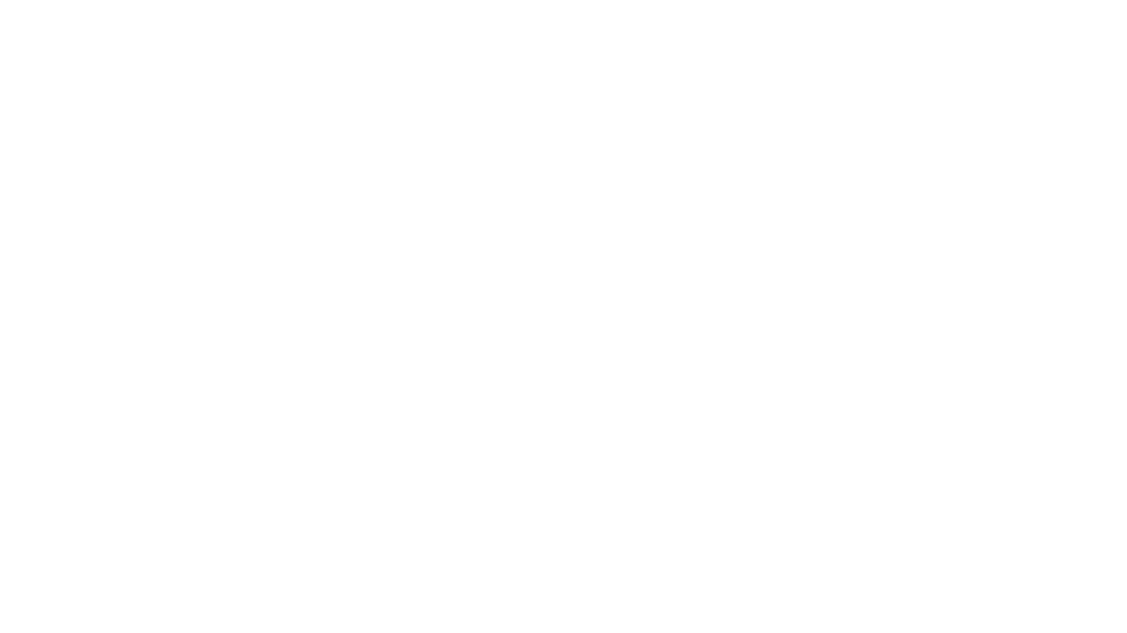
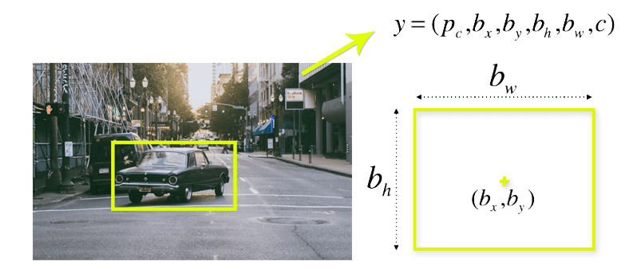
2-Bounding box regression
A bounding box is an outline that highlights an object in an image.
Every bounding box in the image consists of the following attributes:
Width (bw)
Height (bh)
Class (for example, person, car, traffic light, etc.)- This is represented by the letter c.
Bounding box center (bx,by)
The following image shows an example of a bounding box. The bounding box has been represented by a yellow outline.
YOLO uses a single bounding box regression to predict the height, width, center, and class of objects. In the image above, represents the probability of an object appearing in the bounding box.

Slide 7
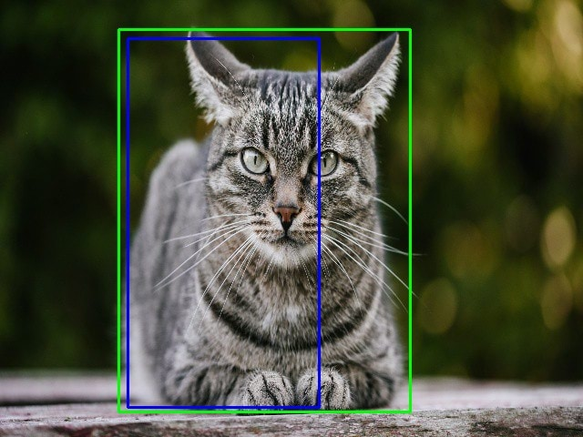
3-Intersection over union (IOU)
Intersection over union (IOU) is a phenomenon in object detection that describes how boxes overlap. YOLO uses IOU to provide an output box that surrounds the objects perfectly.
Each grid cell is responsible for predicting the bounding boxes and their confidence scores. The IOU is equal to 1 if the predicted bounding box is the same as the real box. This mechanism eliminates bounding boxes that are not equal to the real box.
The following image provides a simple example of how IOU works.

Slide 8
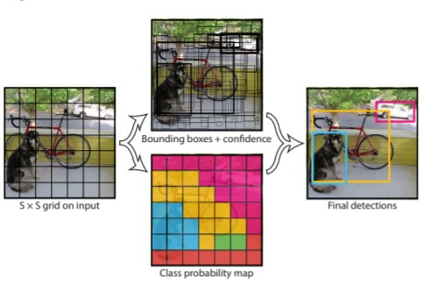
Combination of the three techniques
The following image shows how the three techniques are applied to produce the final detection results.
First, the image is divided into grid cells. Each grid cell forecasts B bounding boxes and provides their confidence scores. The cells predict the class probabilities to establish the class of each object.
For example, we can notice at least three classes of objects: a car, a dog, and a bicycle. All the predictions are made simultaneously using a single convolutional neural network.
Intersection over union ensures that the predicted bounding boxes are equal to the real boxes of the objects. This phenomenon eliminates unnecessary bounding boxes that do not meet the characteristics of the objects (like height and width). The final detection will consist of unique bounding boxes that fit the objects perfectly.
For example, the car is surrounded by the pink bounding box while the bicycle is surrounded by the yellow bounding box. The dog has been highlighted using the blue bounding box.

Slide 9
Comparison with faster r-cnn
YOLO and Faster RCNN both share some similarities. They both uses an anchor box-based network structure, both uses bounding both regression. Things that differs YOLO from Faster RCNN is that it makes classification and bounding box regression at the same time. Judging from the year they were published; it make sense that YOLO wanted a more elegant way to do regression and classification. YOLO however does have its drawback in object detection. YOLO has difficulty detecting objects that are small and close to each other due to only two anchor boxes in a grid predicting only one class of object. It doesn’t generalize well when objects in the image show rare aspects of ratio. Faster RCNN on the other hand, do detect small objects well since it has nine anchors in a single grid, however it fails to do real-time detection with its two-step architecture.

